Slide 1
Cryptography and Computer Security (CSS) Lecture # 3

Slide 2
Introduction to CSS Course (CS401)

Slide 3
Unit II Symmetric Cryptography Techniques
Stream ciphers and block ciphers
Block Cipher structure
Data Encryption standard (DES)
Design principles of block cipher
AES with structure
AES Transformation functions
Key expansion

Slide 4
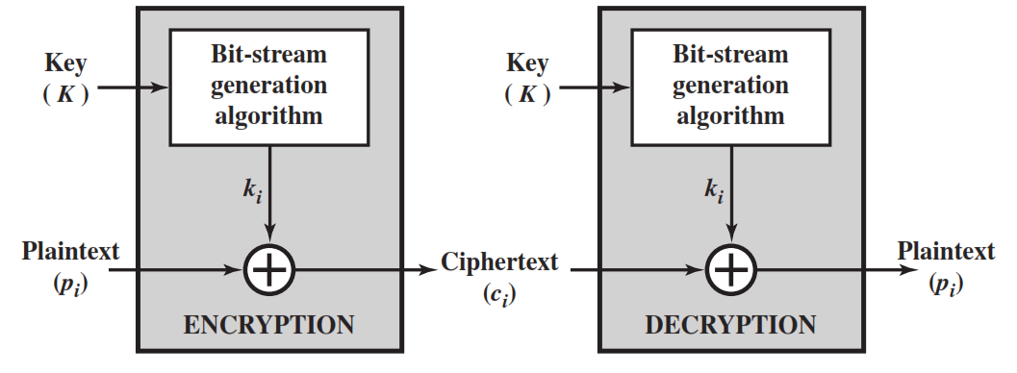
Stream Cipher
A stream cipher is one that encrypts a digital data stream one bit or one byte at a time.
Examples of classical stream ciphers are Autokeyed Vigenère cipher ,A5/1, RC4 and Vernam cipher.

Slide 5
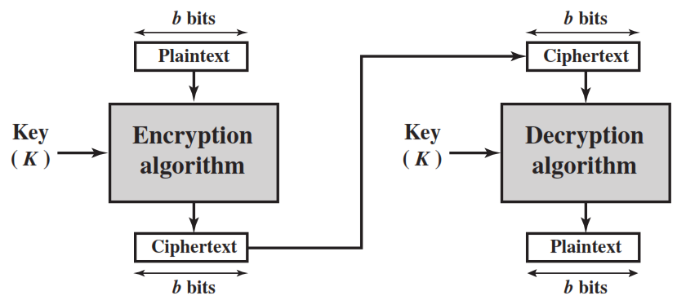
Block Cipher
A block cipher is one in which a block of plaintext is treated as a whole and used to produce a ciphertext block of equal length.
Typically, a block size of 64 or 128 bits is used.
Examples are Feistel Cipher, DES, Triple DES and AES

Slide 6
Diffusion and Confusion
Diffusion hides the relationship between the ciphertext and the plaintext.
This is achieved by having each plaintext digit affect the value of many ciphertext digits.
This is achieved by the use of Transposition/permutation/p-box.
Confusion hides the relationship between the ciphertext and the key.
This is achieved by the use of a complex substitution algorithm or s-box.

Slide 7
Stream Cipher vs Block Cipher
 | Stream Cipher | Block Cipher
Length | Bite or Byte | Block size – 64 or 128 bits
Design | Complex | Simple
Principle | Confusion | Confusion and Diffusion
Speed | Faster | Slower
Encryption | CFB (Cipher Feedback) OFB(Output Feedback) | Electronic Code Block(ECB) Cipher Block Chaining(CBC)
Decryption | XOR | Reverse of encryption
Example | Vernam | DES, AES

Slide 8
Plaintext (2w bits)
Feistel Cipher Structure Or Block Cipher Structure
L₀
w bits
w bits
R₀
Round 1
K₁
F
L₁
R₁
Round i
K_{i}
F
L_{i}
R_{i}
Round n
K_{n}
L_{n}
R_{n}
F
L_{n+1}
R_{n+1}
L_{n}
R_{n}
Ciphertext (2w bits)

Slide 9
Feistel Cipher Structure
Input plaintext block of length 2w bits
key K, Sub-keys: K₁, K₂, …, K_{n} (Derived from K)
All rounds have the same structure.
A substitution is performed by taking exclusive-OR on left half(Li) of the data and the output of round function F which has inputs right half(Ri) and sub key ki.
A permutation is performed that consists of interchange of two halves of data.
This structure is called Substitution-Permutation Network (SPN)

Slide 10
Feistel Network Factors
Block size: Common block size of 64-bit. However, the new algorithms uses a 128-bit, 256-bit block size.
Key size: Key sizes of 64 bits or less are now widely considered to be insufficient, These days at least 128 bit, more better, e.g. 192 or 256 bit
Number of rounds: A typical size is 16 rounds.
Round function F: Again, greater complexity generally means greater resistance to cryptanalysis.
Subkey generation algorithm: Greater complexity in this algorithm should lead to greater difficulty of cryptanalysis.

Slide 11
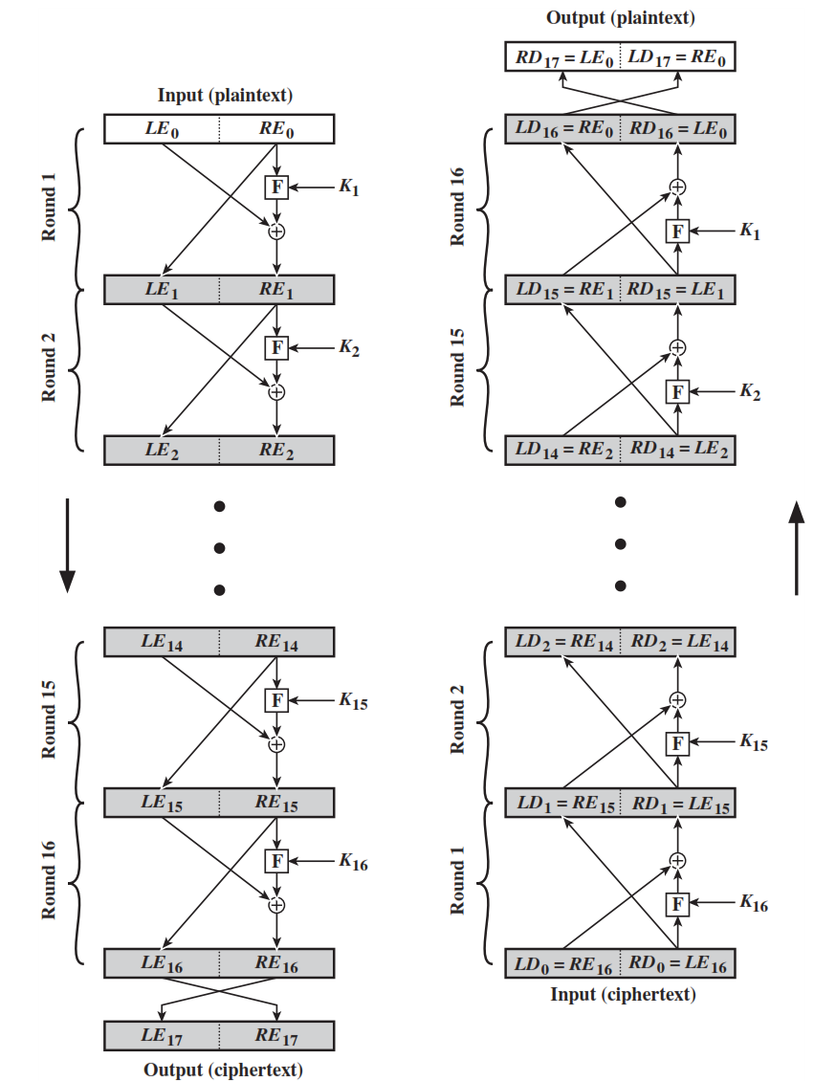





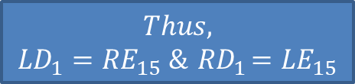

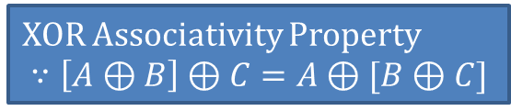
Feistel Encryption & Decryption
Prove that o/p of first round of Decryption is equal to 32-bit swap of i/p of 16th round of Encryption
LD₁=RE₁₅ & RD₁=LE₁₅
On Encryption Side:
$${LE}_{16}={RE}_{15}$$
$${RE}_{16}={LE}_{15} ⊕F({RE}_{15},K_{16})$$
On Decryption Side:
$${LD}_{1}={RD}_{0}={LE}_{16}={RE}_{15}$$
$${RD}_{1}={LD}_{0} ⊕F\left({RD}_{0},K_{16}\right)$$
$$={RE}_{16} ⊕F\left({RE}_{15},K_{16}\right)$$
$$={[LE}_{15} ⊕F\left({RE}_{15},K_{16}\right)] ⊕F\left({RE}_{15},K_{16}\right)$$
XOR Associativity Property
$$∵\left[A⊕B\right]⊕C=A⊕[B⊕C]$$
$$Thus,$$
$${LD}_{1}={RE}_{15} \&{ RD}_{1}={LE}_{15}$$

Slide 12
Data Encryption Standard (DES)
Symmetric Block Cipher
A.k.a. - Data Encryption Algorithm (DEA)
Adopted in NIST in 1977
Input – 64 bits as block
Output – 64 bits as block
Main Key Size – 64-bit, with only 56-bit effective (i.e. Subkey)
Round Key – 48 bits
Number of Rounds: 16
Advanced Encryption Standard (AES) in 2001

Slide 13
64-bit plaintext
64-bit key
Initial Permutation
Permuted choice 1
64
56
Round 1
K₁
48
Permuted choice 2
56
Left circular shift
64
56
Round 2
K₂
48
Permuted choice 2
56
Left circular shift
Round 16
K₁₆
48
Permuted choice 2
56
Left circular shift
32-bit swap
64
DES Encryption Algorithm
Inverse
Initial Permutation
64-bit ciphertext

Slide 14
Initial Permutation
First, the 64-bit plaintext passes through an initial permutation (IP) that rearranges the bits to produce the permuted input.
1 | 2 | 3 | 4 | 5 | 6 | 7 | 8
9 | 10 | 11 | 12 | 13 | 14 | 15 | 16
17 | 18 | 19 | 20 | 21 | 22 | 23 | 24
25 | 26 | 27 | 28 | 29 | 30 | 31 | 32
33 | 34 | 35 | 36 | 37 | 38 | 39 | 40
41 | 42 | 43 | 44 | 45 | 46 | 47 | 48
49 | 50 | 51 | 52 | 53 | 54 | 55 | 56
57 | 58 | 59 | 60 | 61 | 62 | 63 | 64
58 | 50 | 42 | 34 | 26 | 18 | 10 | 2
60 | 52 | 44 | 36 | 28 | 20 | 12 | 4
62 | 54 | 46 | 38 | 30 | 22 | 14 | 6
64 | 56 | 48 | 40 | 32 | 24 | 16 | 8
57 | 49 | 41 | 33 | 25 | 17 | 9 | 1
59 | 51 | 43 | 35 | 27 | 19 | 11 | 3
61 | 53 | 45 | 37 | 29 | 21 | 13 | 5
63 | 55 | 49 | 39 | 31 | 23 | 15 | 7

Slide 15
Inverse Initial Permutation
Finally, the preoutput is passed through a permutation that is the inverse of the initial permutation function, to produce the 64-bit ciphertext.
1 | 2 | 3 | 4 | 5 | 6 | 7 | 8
9 | 10 | 11 | 12 | 13 | 14 | 15 | 16
17 | 18 | 19 | 20 | 21 | 22 | 23 | 24
25 | 26 | 27 | 28 | 29 | 30 | 31 | 32
33 | 34 | 35 | 36 | 37 | 38 | 39 | 40
41 | 42 | 43 | 44 | 45 | 46 | 47 | 48
49 | 50 | 51 | 52 | 53 | 54 | 55 | 56
57 | 58 | 59 | 60 | 61 | 62 | 63 | 64
40 | 8 | 48 | 16 | 56 | 24 | 64 | 32
39 | 7 | 47 | 15 | 55 | 23 | 63 | 31
38 | 6 | 46 | 14 | 54 | 22 | 62 | 30
37 | 5 | 45 | 13 | 53 | 21 | 61 | 29
36 | 4 | 44 | 12 | 52 | 20 | 60 | 28
35 | 3 | 43 | 11 | 51 | 19 | 59 | 27
34 | 2 | 42 | 10 | 50 | 18 | 58 | 26
33 | 1 | 41 | 9 | 49 | 17 | 57 | 25

Slide 16
DES Summary
First, the 64-bit plaintext passes through an initial permutation (IP) that rearranges the bits to produce the permuted input.
This is followed by a phase consisting of sixteen rounds of the same function, which involves both permutation and substitution functions.
Finally, the preoutput is passed through a permutation that is the inverse of the initial permutation function, to produce the 64-bit ciphertext.
The 56-bit key is passed through a permutation function.
For each of the sixteen rounds, a subkey (K_{i}) is produced by the combination of a left circular shift and a permutation.

Slide 17
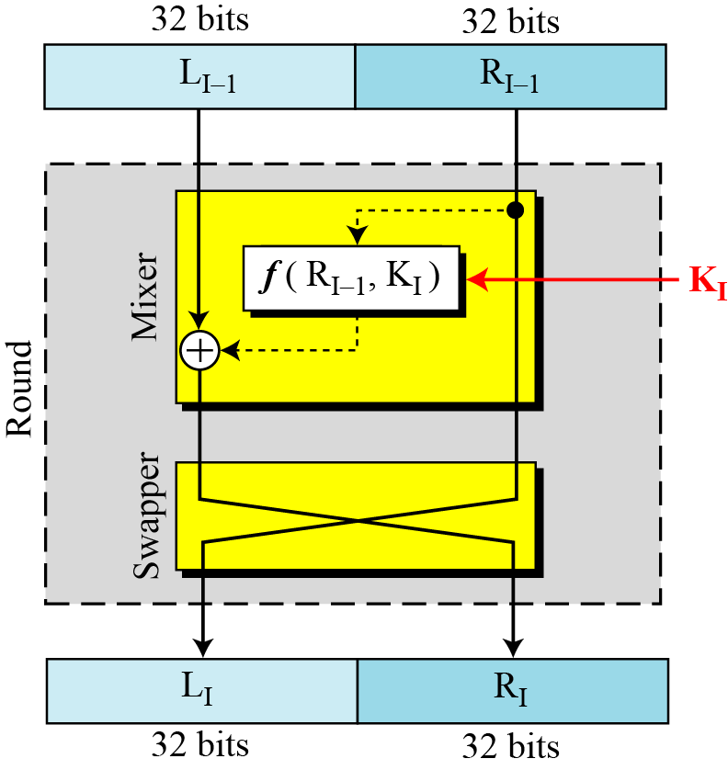
DES Single Round

Slide 18








32-bits
32-bits
28-bits
28-bits
$$L_{i−1}$$
$$R_{i−1}$$
$$C_{i−1}$$
$$D_{i−1}$$
Expansion/ permutation
(E table)
Left Shift
(S)
Left Shift
(S)
48
K_{i}
Permutation/ compression
(Permuted choice 2)
XOR
48
48
Substitution/choice
(S-box)
32 | 1 | 2 | 3 | 4 | 5
4 | 5 | 6 | 7 | 8 | 9
8 | 9 | 10 | 11 | 12 | 13
12 | 13 | 14 | 15 | 16 | 17
16 | 17 | 18 | 19 | 20 | 21
20 | 21 | 22 | 23 | 24 | 25
24 | 25 | 26 | 27 | 28 | 29
28 | 29 | 30 | 31 | 32 | 1
32
Permutation
(P)
32
XOR
$$L_{i}$$
$$R_{i}$$
$$C_{i}$$
$$D_{i}$$
Notes:
confusion step is the S-box substitution, while the diffusion step is where the output of the S-boxes is rearranged according to the P-box permutation rules.

Slide 19
DES Single Round Summary
Key Transformation
Permutation of selection of sub-key from original key
Expansion Permutation (E-table)
Right half is expanded from 32-bits to 48-bits
S-box Substitution
Accepts 48-bits from XOR operation and produce 32-bits using 8 substitution boxes (each S-boxes has a 6-bit i/p and 4-bit o/p).
P-Box Permutation
XOR and Swap

Slide 20
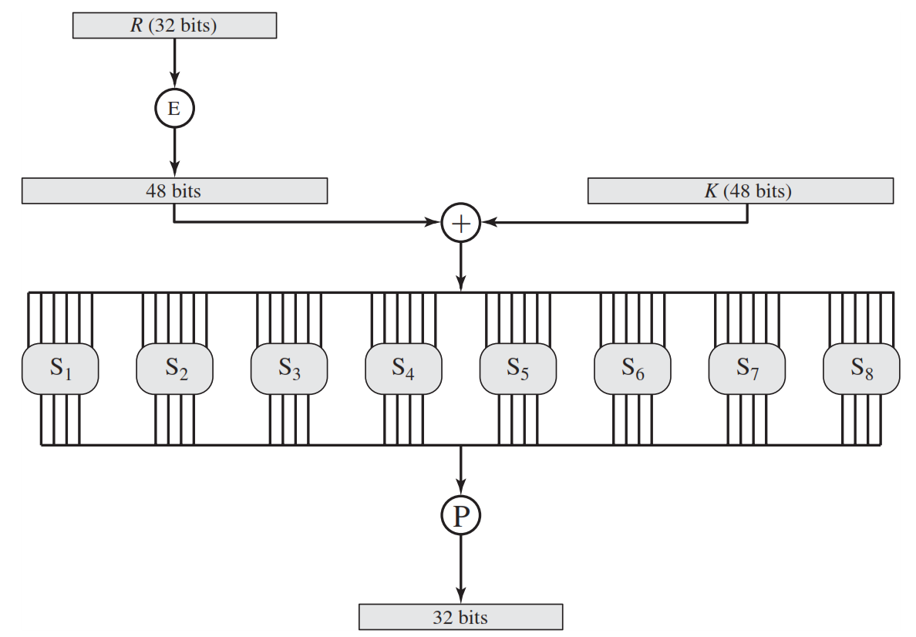
Role of S-box

Slide 21
Role of S-box (Cont…)
The outer two bits of each group select one row of an S-box.
Inner four bits selects one column of an S-box.
S-box 1
Example:
Input
0 | 1 | 1 | 0 | 0 | 1
Output
1 | 0 | 0 | 1
Row
Column

Slide 22
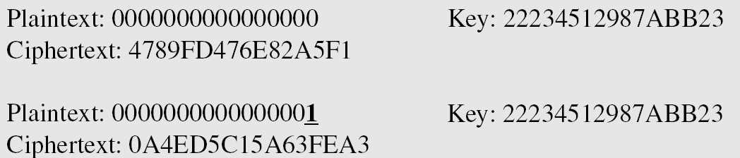
Avalanche Effect
Desirable property of any encryption algorithm is that a change in one bit of the plaintext or of the key should produce a change in many bits of cipher text.
DES performs strong avalanche effect.
Although the two plaintext blocks differ only in the rightmost bit, the ciphertext blocks differ in 29 bits.
This means that changing approximately 1.5 % of the plaintext creates a change of approximately 45 % in the ciphertext.

Slide 23
Introduction to Advanced Encryption Standard (AES) by AVN

Slide 24
AES (Advanced Encryption Standard)
Outline
Understand the basics of AES
AES Input and Output
Data Units
Block to State and State to Block
AES structure
AES parameters

Slide 25
AES (Advanced Encryption Standard)
Advanced Encryption Standard
NIST in 2001
Symmetric – Same key at encryption and decryption
block cipher – consider block as input

Slide 26
AES - I/O and O/P
Plaintext (128 bits)
AES
Key (128 or 192 or 256 bits)
Ciphertext (128 bits)

Slide 27
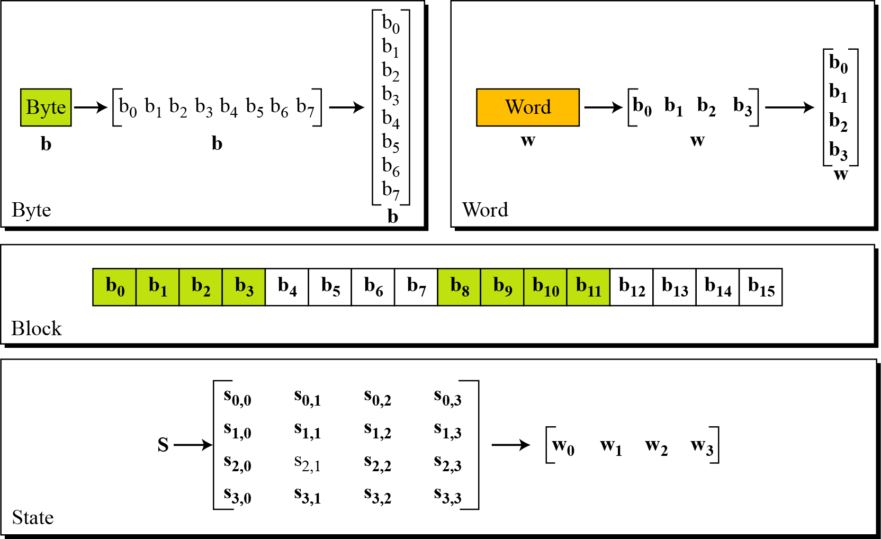
Data Units in AES

Slide 28
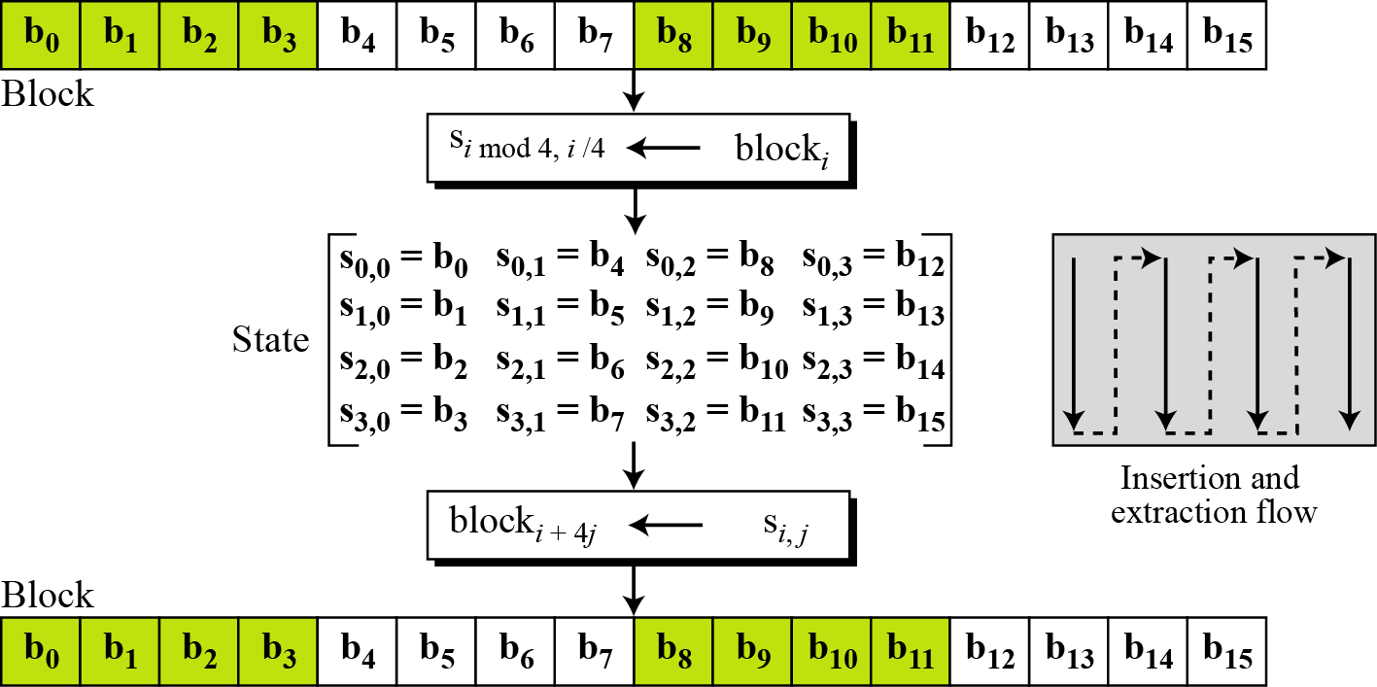
AES - Block to State & State to Block

Slide 29
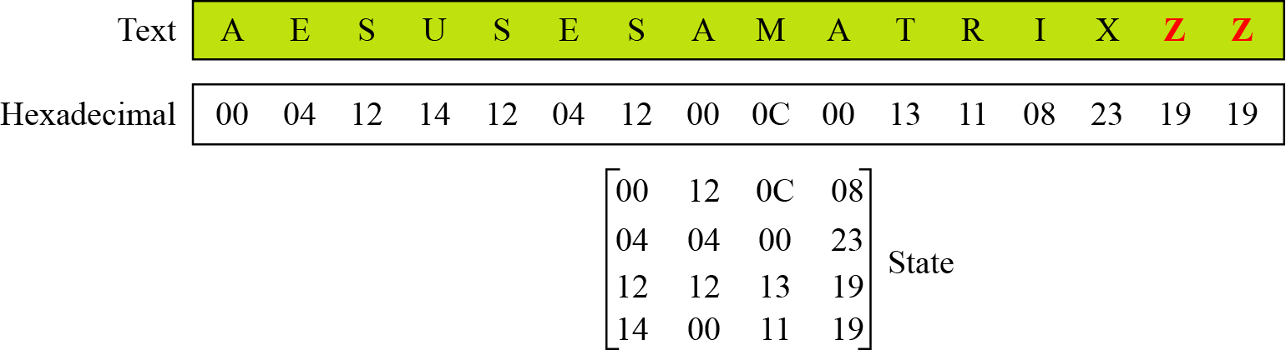
AES - Plain Text to State

Slide 30
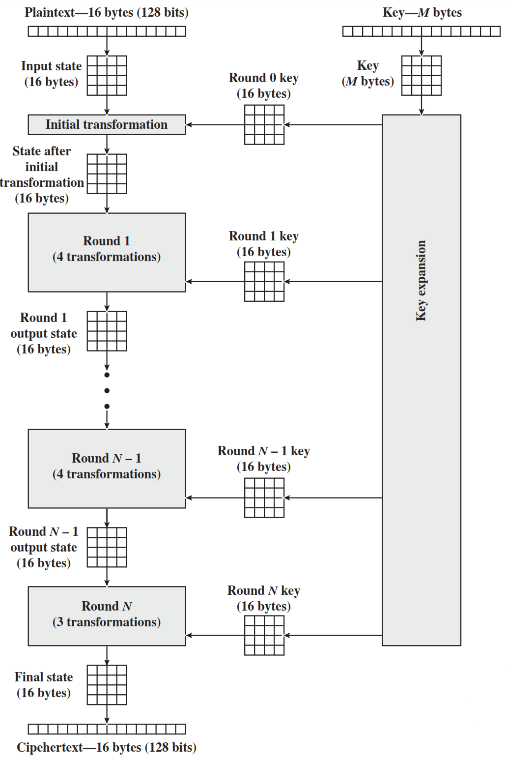
AES Structure
No of rounds | Key size (in bits)
10 | 128
12 | 192
14 | 256

Slide 31
AES Parameters
 | AES-128 | AES-192 | AES-256
Key size | 128 | 192 | 256
Plainttext Size | 128 | 128 | 128
No. of Rounds | 10 | 12 | 14
Round Key Size | 128 | 128 | 128

Slide 32
AES Encryption and Decryption

Slide 33
AES (Advanced Encryption Standard)
Outline
Recall the AES structure and the relationship between the key size and number of rounds
Understand the AES encryption and decryption
Know the various transformations in AES encryption and decryption process

Slide 34
AES Structure
No of rounds | Key size (in bits)
10 | 128
12 | 192
14 | 256

Slide 35
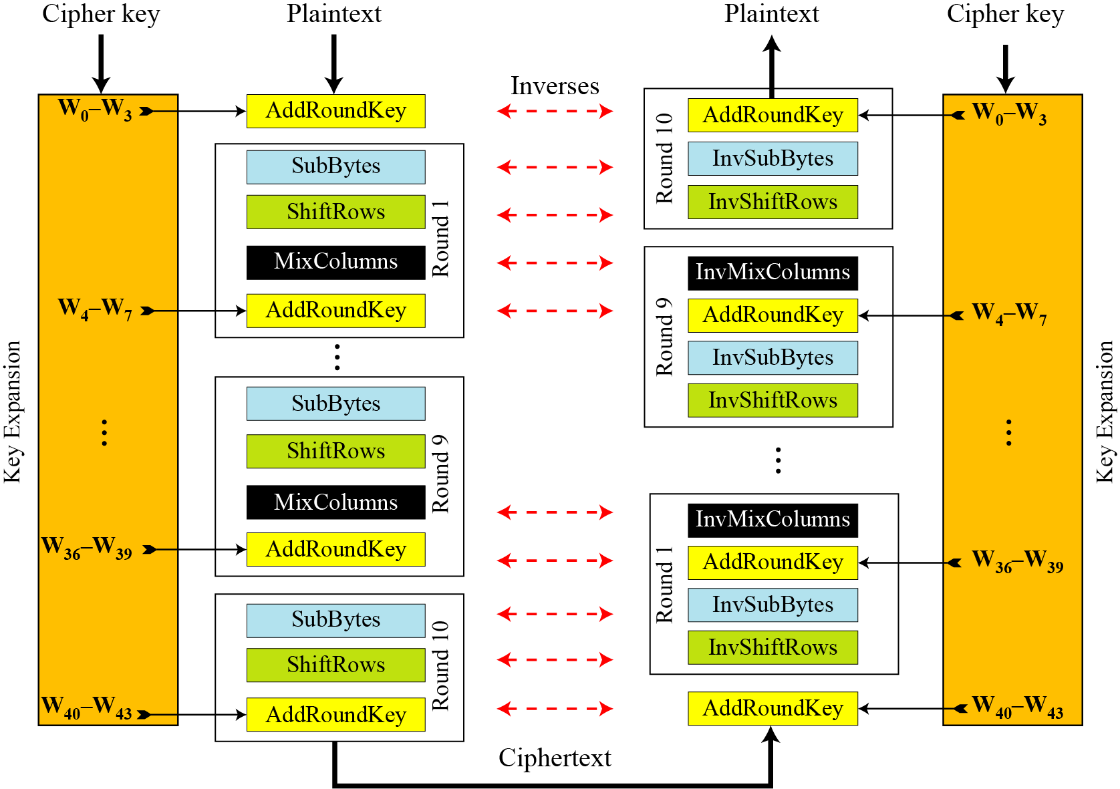
AES Encryption and Decryption

Slide 36
AES Round Transformation

Slide 37
AES Round Transformation
Outline
Understand the four transformation in AES encryption and decryption process

Slide 38
AES Structure
No of rounds | Key size (in bits)
10 | 128
12 | 192
14 | 256

Slide 39
AES Encryption and Decryption

Slide 40
AES Transformation Functions
Substitute Bytes ------ It is Substitution or S-box
Shifts Rows ------ It is Permutation or P-box
Mix Columns ------ It is Substitution or S-box
Add Round Key ------ It is Substitution or S-box

Slide 41
AES Structure
The first N-1 rounds consist of four distinct transformation functions.
SubBytes
The 16 input bytes are substituted using an S-box
ShiftRows
Each of the four rows of the matrix is shifted to the left
MixColumns
Each column of four bytes is now transformed using a special mathematical function.
AddRoundKey
The 16 bytes of the matrix are now considered as 128 bits and are XORed to the 128 bits of the round key.

Slide 42
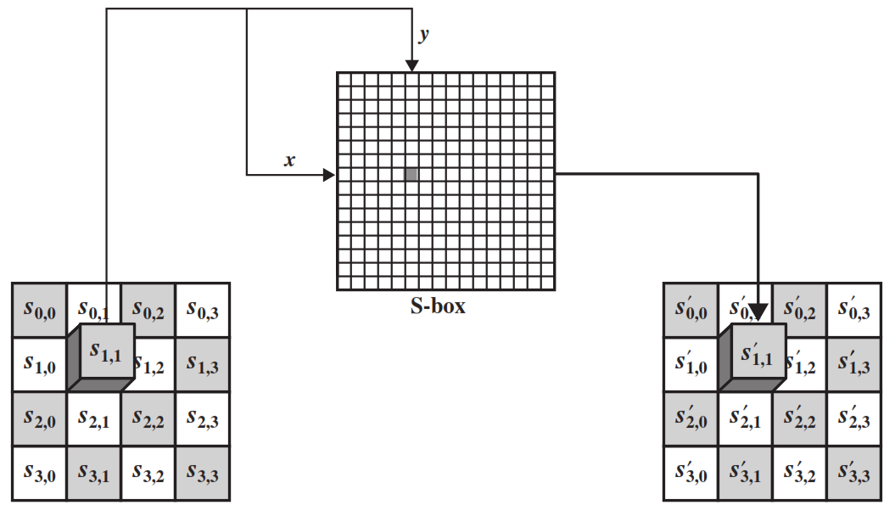
SubByte Transformation
The forward substitute byte transformation, called SubBytes, is a simple table lookup

Slide 43
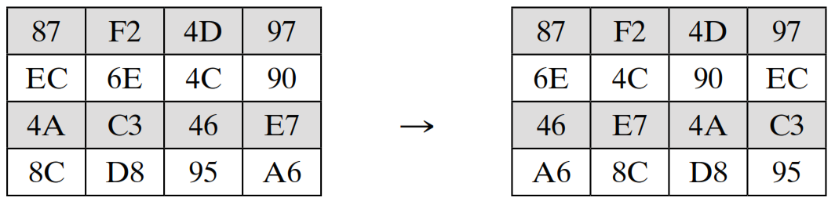
Shift Rows
The first row of State is not altered.
For the second row, a 1-byte circular left shift is performed.
For the third row, a 2-byte circular left shift is performed.
For the fourth row, a 3-byte circular left shift is performed.
S_{0,0} | S_{0,1} | S_{0,2} | S_{0,3}
S_{1,0} | S_{1,1} | S_{1,2} | S_{1,3}
S_{2,0} | S_{2,1} | S_{2,2} | S_{2,3}
S_{3,0} | S_{3,1} | S_{3,2} | S_{3,3}
S_{0,0} | S_{0,1} | S_{0,2} | S_{0,3}
S_{1,1} | S_{1,2} | S_{1,3} | S_{1,0}
S_{2,2} | S_{2,3} | S_{2,0} | S_{2,1}
S_{3,3} | S_{3,0} | S_{3,1} | S_{3,2}

Slide 44
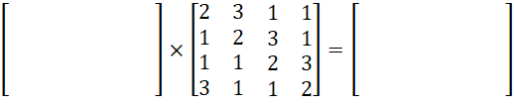
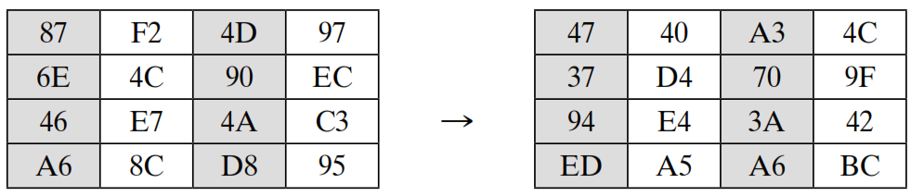
Mix Columns
Each byte of a column is mapped into a new value that is a function of all four bytes in that column.
S_{0,0} | S_{0,1} | S_{0,2} | S_{0,3}
S_{1,0} | S_{1,1} | S_{1,2} | S_{1,3}
S_{2,0} | S_{2,1} | S_{2,2} | S_{2,3}
S_{3,0} | S_{3,1} | S_{3,2} | S_{3,3}
T_{0,0} | T_{0,1} | T_{0,2} | T_{0,3}
T_{1,0} | T_{1,1} | T_{1,2} | T_{1,3}
T_{2,0} | T_{2,1} | T_{2,2} | T_{2,3}
T_{3,0} | T_{3,1} | T_{3,2} | T_{3,3}

Slide 45
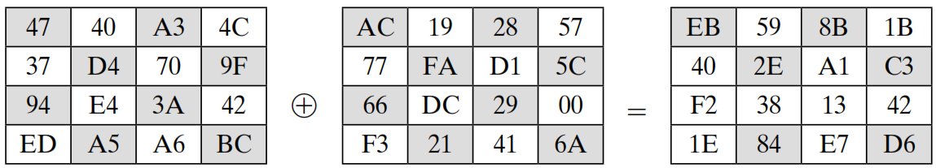
Add Round Key
In the forward add round key transformation, the 128 bits of State are bitwise XORed with the 128 bits of the round key.
S_{0,0} | S_{0,1} | S_{0,2} | S_{0,3}
S_{1,0} | S_{1,1} | S_{1,2} | S_{1,3}
S_{2,0} | S_{2,1} | S_{2,2} | S_{2,3}
S_{3,0} | S_{3,1} | S_{3,2} | S_{3,3}
W_{i} W_{i+1} W_{i+2} W_{i+3}
T_{0,0} | T_{0,1} | T_{0,2} | T_{0,3}
T_{1,0} | T_{1,1} | T_{1,2} | T_{1,3}
T_{2,0} | T_{2,1} | T_{2,2} | T_{2,3}
T_{3,0} | T_{3,1} | T_{3,2} | T_{3,3}
⊕
State
Round Key

Slide 46
AES Key Expansion

Slide 47
Objectives
Understand the AES key Expansion Process

Slide 48
AES Structure
No of rounds | Key size (in bits)
10 | 128
12 | 192
14 | 256

Slide 49
AES Encryption and Decryption

Slide 50
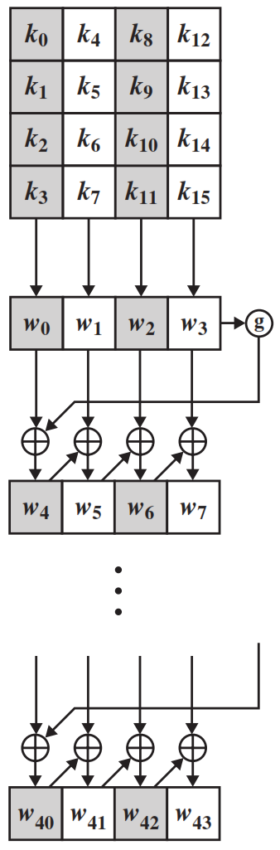
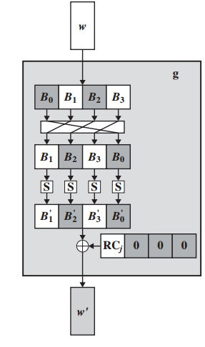
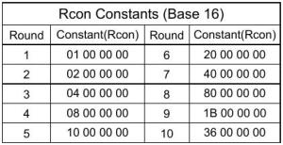
AES Key Expansion
The AES key expansion algorithm takes as input a four-word (16-byte) key and produces a linear array of 44 words (176 bytes).
Each added word w[i] depends on the immediately preceding word, w[i - 1].
In three out of four cases, a simple XOR is used.

Slide 51
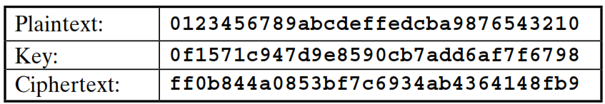
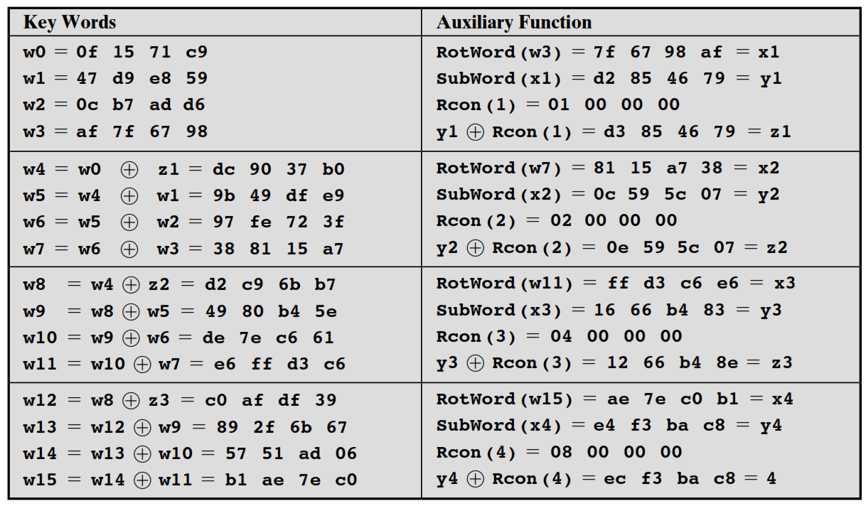
Key Expansion Example

Slide 52
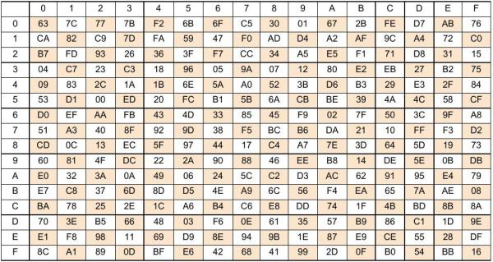
S-box of AES key Expansion

